Slide 1
Perception of Non-rigid 3D Shapes from Motion Cues
Qasim Zaidi & Anshul Jain
Graduate Center for Vision Research
SUNY College of Optometry

Slide 2
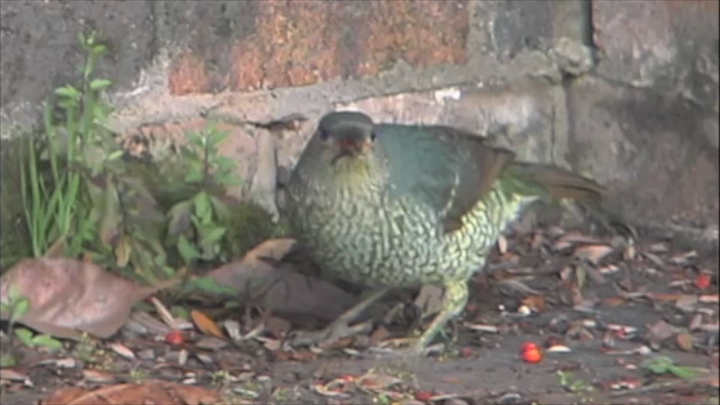

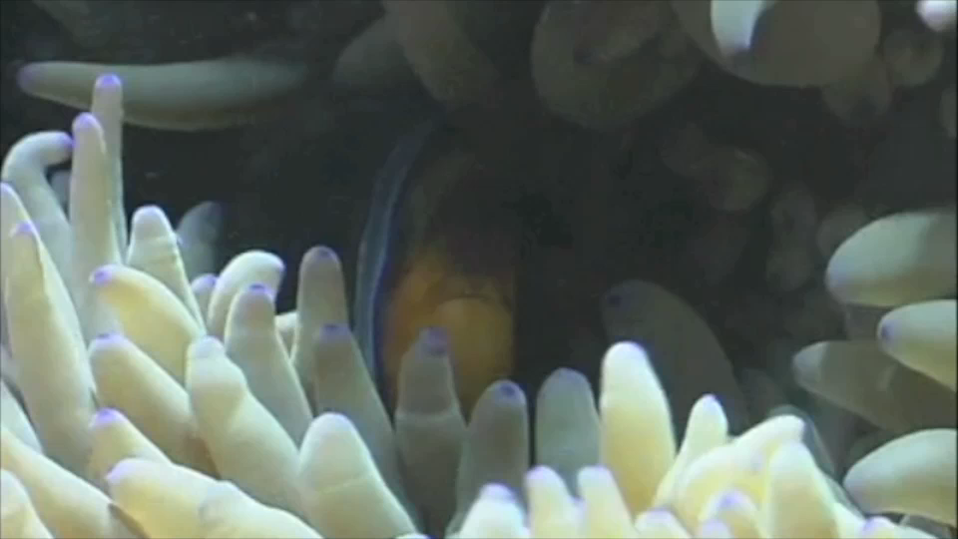
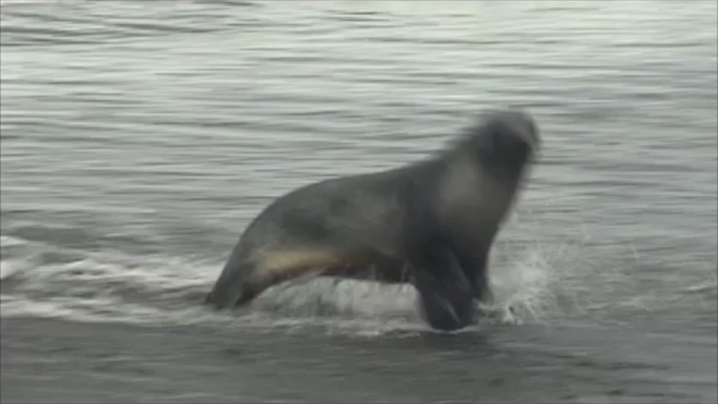
Many objects deform as they move
Clips taken from bioMovies @ NCSU
Surprisingly, there are no psychophysical studies that deal with disentangling general shape changes from object motion

Slide 3
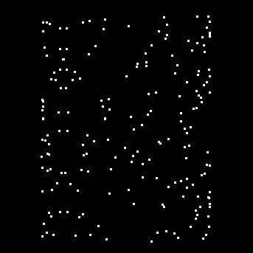
Extracting Rigid 3-D Shape-from-Motion
Incremental Rigidity:
  e.g. Ullman (1984), Grzywacz & Hildreth (1985)
Motion Perspective:
  e.g. Helmhotz (1925), Gibson et al. (1955), Sperling et al. (1989)
Local Def based
  e.g. Longuet-Higgins & Prazdny, 1980; Koenderink, 1986; Domini et al. 2003

Slide 4
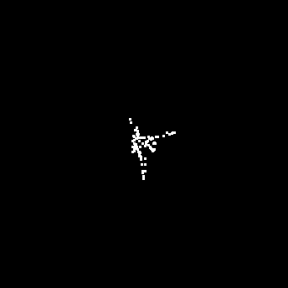
Extracting Non-rigid 3-D Shape-from-Motion
Biological Motion
  Johansson, 1973 and many others
  Neural model based on snapshot neurons (Giese & Poggio, 2003)
But what about more general shapes?

Slide 5
Factorization Method (Tomasi & Kanade, 1992)
F views of P points (u,v) of a 3-D rigid shape S give the image matrix W, which has to be factorized into a Rotation R and a Shape matrix S.
Since S is 3-D, Rank(W) = 3, so the three largest eigen-values from an SVD give the non-unique factorization:
To obtain the unique R from R’, using the orthonormal property of a rotation matrix, we find Q such that,
Then the 3-D shape is estimated by:

Slide 6
Extension to Non-rigid Shapes
Since, the shape changes on every frame the shape matrix now is:
Frames
(x,y,z) Points of 3-D Shape

Slide 7
Extension to Non-rigid Shapes
Since, the shape changes on every frame the shape matrix now is:
Trajectory Space
Shape Space
Shape basis (Bregler et al., 2000):
Trajectory basis (Akhter et al., 2008):

Slide 8
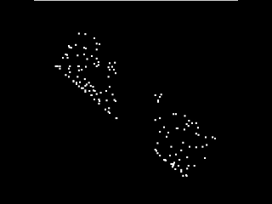
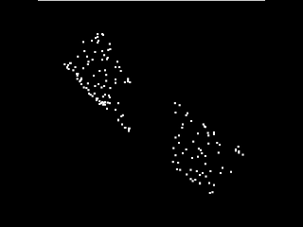
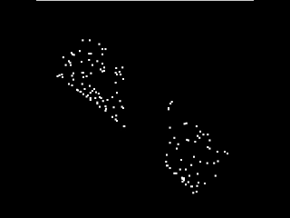
Experiment 1 – Categorical judgments for non-rigid shapes
Question: Do observers judge deviations from circularity of a cylinder for non-rigid shapes as well as they do for rigid shapes?
Stimuli
  Point-light cylinders of varying cross-section with occluded central segments
  Rotation (duration 1s): 120 deg/sec about z-axis; 180 deg/sec about y-axis
Task: 2AFC task – Deeper OR Shallower than perfect cylinder
Rigid Cylinder
Depth-flex Cylinder
Plane-flex Cylinder

Slide 9
Results – Experiment 1 (8 observers)
The psychometric curves have similar slopes, implying similar sensitivity.
The mean point of subjective circularity is within 20% of veridical
5/8 observers perceived NRP cylinders as deepest
5/8 observers perceived FR cylinders as shallowest
Depth/Width Ratio

Slide 10
Trajectory based Model
Since, the objects usually deform smoothly, the trajectories of points in 3-D space can be modeled as a linear combination of basis trajectories e.g. oscillations of different frequencies.
For the trajectory of each point, we can thus estimate the linear coefficients of cosine trajectories, which together define the 3-D non-rigid shape (Akhter et al., 2008):
=
A₀ *
+ A₁ *
… + A_{K} *

Slide 11
Trajectory-based Predictions - Experiment 1

Slide 12
Motion Perspective Model
Observers assume that near points move faster than far points (Helmhotz, Gibson).
For each frame we computed the instantaneous local velocity at an image point (i,j)
Then, for a small slice across the cross-section we computed the Velocity Contrast Metric (VCM)
The VCM for each stimulus was computed by averaging across all slices for all frames.

Slide 13
Motion Perspective based Predictions - Experiment 1

Slide 14
Modeling Results - Experiment 1
The trend in the observed data were explained better by the simple Motion Perspective model than by the Trajectory based model.
Stimuli with higher Velocity Contrast Metric were generally perceived as deeper (NRP) and stimuli with lower VCM were generally perceived as shallower (FR)

Slide 15
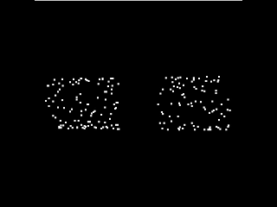
Experiment 2 – Asymmetric Percepts from Symmetric Cylinders
Simple Motion
Complex Motion
Stimuli
  The stimuli were constructed in the same manner as in Experiment 1.
  Rotation: Simple (only about Y-axis) or Complex (about Y- and Z-axes)
Task
  2AFC task: symmetric or asymmetric cylinder

Slide 16
Results – Experiment 2 (6 observers)

Slide 17
Velocity Profile – Plane-flex cylinder
Increasing Velocity
Simple Motion
Aspect Ratio = 0.71
Aspect Ratio = 1
Aspect Ratio = 1.41
Under simple motion the profile is symmetric around the horizontal mid-section of the cylinder.
Complex Motion
Aspect Ratio = 0.71
Aspect Ratio = 1
Aspect Ratio = 1.41
Under complex motion, the peak is shifted to the top; the profile is asymmetric along the width of the cylinder.

Slide 18
Asymmetry Metric (AM)
Shape Profile as Simulated
Shape Profile as Computed from Model
Cylinder Depth
Cylinder Width
Asymmetry Metric = Mean-squared error

Slide 19
Motion Perspective Model - Experiment 2

Slide 20
Trajectory Space Model - Experiment 2

Slide 21
Modeling Results - Experiment 2
Asymmetry in the velocity profile is reflected in the percept
Neither of the two models can entirely explain the percept

Slide 22
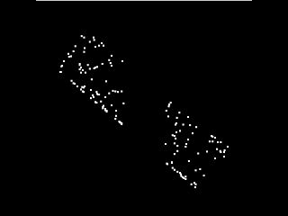
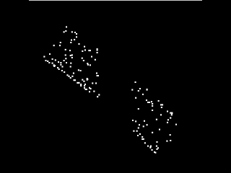
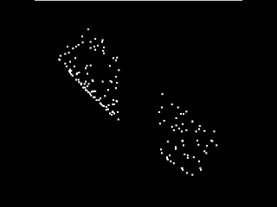
Experiment 3 – Detection of Inflation/Deflation in presence of Non-rigidities
Rigid Inflation
Plane-flex Deflation
Depth-flex Inflation
Stimuli
  The stimuli were constructed in the same manner as in Experiment 1.
  The stimuli inflated/deflated smoothly for the first half and then deflated/inflated for the second half of the presentation
Task
  2AFC judgment: inflation followed by deflation or the opposite sequence

Slide 23
Results – Experiment 3 (9 untrained observers)
90% Inflation
50% Inflation
25% Inflation
90% Deflation
50% Deflation
25% Deflation
Time

Slide 24
82% Accuracy Thresholds – Experiment 3
(4 trained observers)

Slide 25
Changes in VCM due to Inflation/Deflation
Simulated % Shape Change
Computed % Shape Change
The velocity based metric extracts the simulated change fairly well.

Slide 26
Changes in Trajectory based Shape due to Inflation/Deflation
Simulated % Shape Change
Computed % Shape Change
The trajectory based metric does not fit as well as the velocity based metric

Slide 27
Conclusions
Human observers can judge shapes of non-rigid objects as well as they do for rigid objects.
The human perceptual system does not require a rigidity assumption to extract 3-D shape from motion cues.
The perceptual system presumably relies on velocity measurements to compute the structure
Detecting inflation or deflation in depth of rigid and non-rigid bodies is extremely difficult without extensive experience.
Supported by: NEI grants EY07556 & EY13312 to QZ

